Slide 1

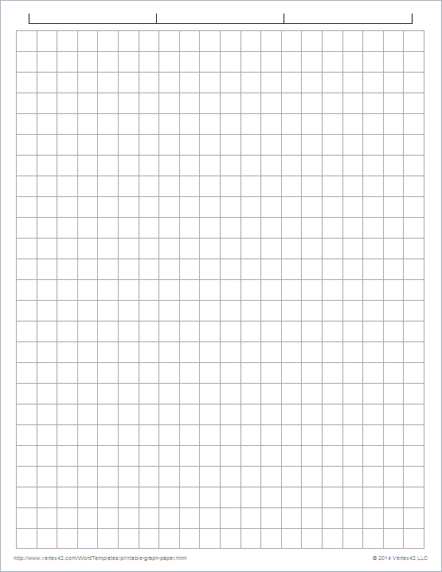
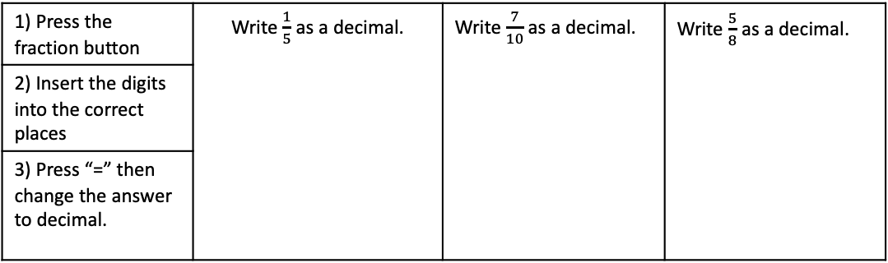
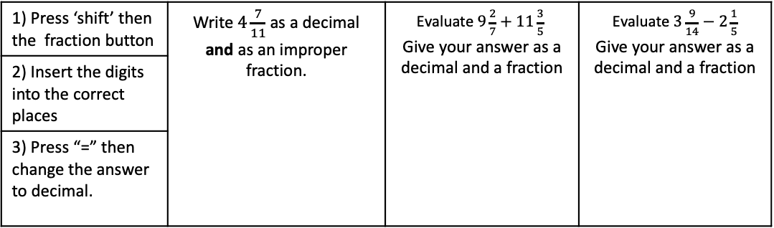
Subtopic 8 – Using a Calculator
LEARNING OUTCOME: Understand how to carry out basic skills on a calculator
Objectives:
Keywords:
function key
shift key
Use some of the important keys when working on a calculator.
Look at some key functions
Use a calculator to solve questions.
Notes: Use this space to note down any useful buttons your teacher tells you
Example 1 - I do…
Example 2 - We do…
Example 3 – You do…
1) Press the fraction button | Write $\frac{1}{5}$ as a decimal. | Write $\frac{7}{10}$ as a decimal. | Write $\frac{5}{8}$ as a decimal.
2) Insert the digits into the correct places
3) Press “=” then change the answer to decimal.
Example 4 - I do…
Example 5 - We do…
Example 6 – You do…
1) Press ‘shift’ then the fraction button | Write $4\frac{7}{11}$ as a decimal and as an improper fraction. | Evaluate $9\frac{2}{7}+11\frac{3}{5}$ Give your answer as a decimal and a fraction | Evaluate $3\frac{9}{14}−2\frac{1}{5}$ Give your answer as a decimal and a fraction
2) Insert the digits into the correct places
3) Press “=” then change the answer to decimal.

Slide 2
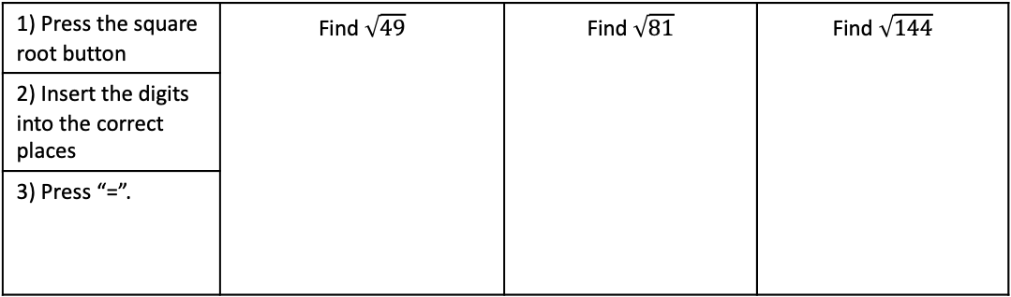
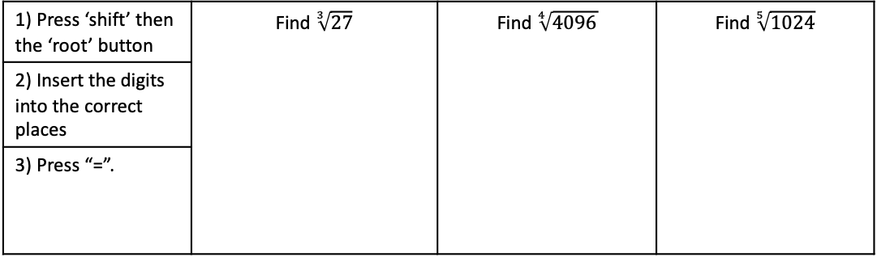
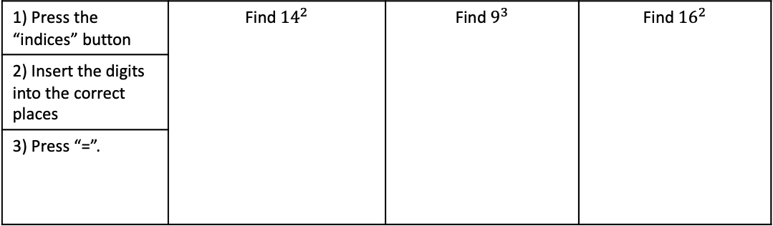
Notes:
Example 7 - I do…
Example 8 - We do…
Example 9 – You do…
1) Press the square root button | Find $\sqrt{49}$ | Find $\sqrt{81}$ | Find $\sqrt{144}$
2) Insert the digits into the correct places
3) Press “=”.
Notes:
Example 10- I do…
Example 11 - We do…
Example 12 – You do…
1) Press the “indices” button | Find ${14}^{2}$ | Find $9^{3}$ | Find ${16}^{2}$
2) Insert the digits into the correct places
3) Press “=”.
Notes:
Example 13 - I do…
Example 14 - We do…
Example 15 – You do…
1) Press ‘shift’ then the ‘root’ button | Find $\sqrt[3]{27}$ | Find $\sqrt[4]{4096}$ | Find $\sqrt[5]{1024}$
2) Insert the digits into the correct places
3) Press “=”.

Slide 3
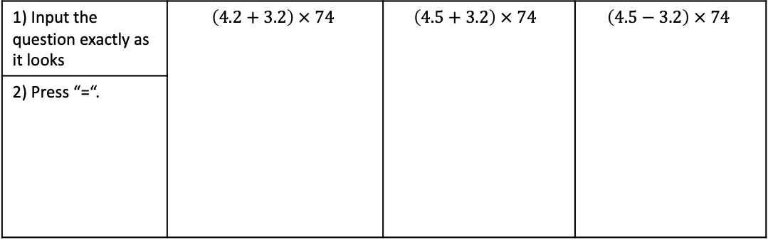
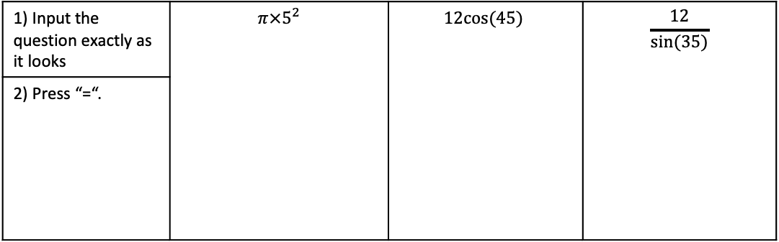
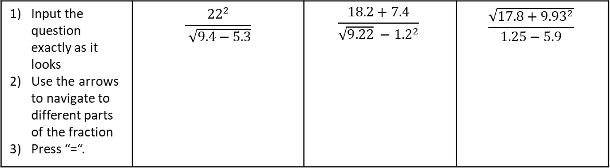
Notes:
Example 16 - I do…
Example 17 - We do…
Example 18 – You do…
1) Input the question exactly as it looks | $$\left(4.2+3.2\right) × 74$$ | $$\left(4.5+3.2\right) × 74$$ | $$\left(4.5−3.2\right) × 74$$
2) Press “=“.
Notes:
Example 19 - I do…
Example 20 - We do…
Example 21 – You do…
Input the question exactly as it looks Use the arrows to navigate to different parts of the fraction Press “=“. | $$\frac{{22}^{2}}{ \sqrt{9.4−5.3}}$$ | $$\frac{18.2+7.4}{\sqrt{9.22} −{1.2}^{2}}$$ | $$\frac{\sqrt{17.8+{9.93}^{2}}}{1.25−5.9}$$
Notes:
Example 22 - I do…
Example 23 - We do…
Example 24 – You do…
1) Input the question exactly as it looks | $$π×5^{2}$$ | $$12cos⁡(45)$$ | $$\frac{12}{sin⁡(35)}$$
2) Press “=“.

Slide 4
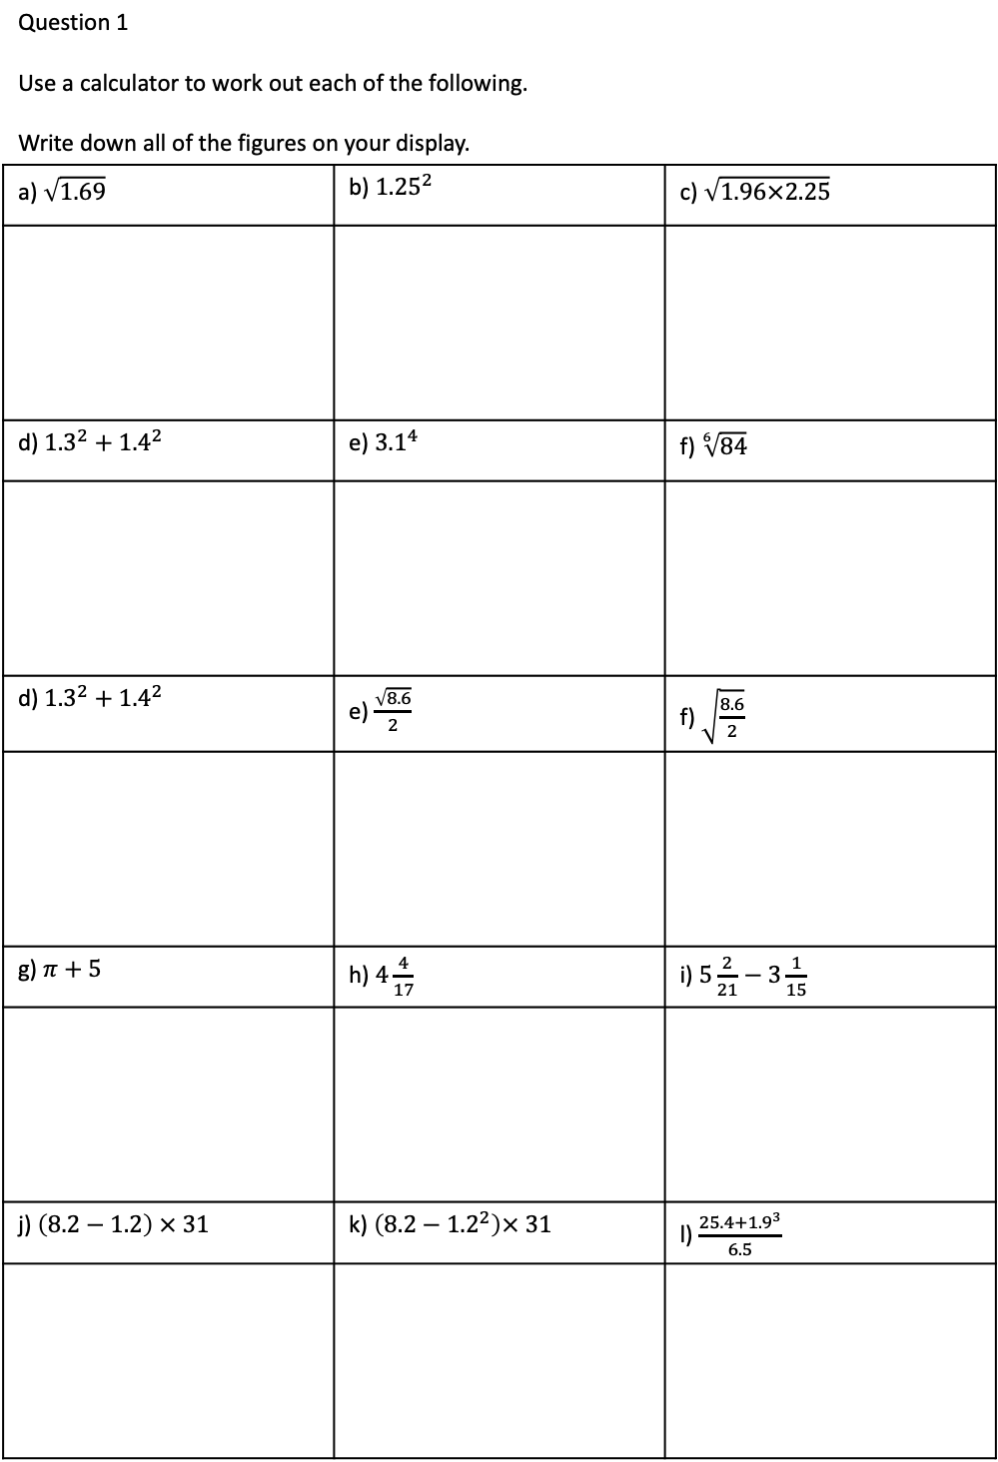
Independent Practice
Question 1 Use a calculator to work out each of the following. Write down all of the figures on your display.
a) $\sqrt{1.69}$ | b) ${1.25}^{2}$ | c) $\sqrt{1.96×2.25}$
d) ${1.3}^{2}+{1.4}^{2}$ | e) ${3.1}^{4}$ | f) $\sqrt[6]{84}$
d) ${1.3}^{2}+{1.4}^{2}$ | e) $\frac{\sqrt{8.6}}{2}$ | f) $\sqrt{\frac{8.6}{2}}$
g) $π+5$ | h) $4\frac{4}{17}$ | i) $5\frac{2}{21}−3\frac{1}{15}$
j) $\left(8.2−1.2\right) × 31$ | k) $\left(8.2−{1.2}^{2}\right)× 31$ | l) $\frac{25.4+{1.9}^{3}}{6.5}$

Slide 5
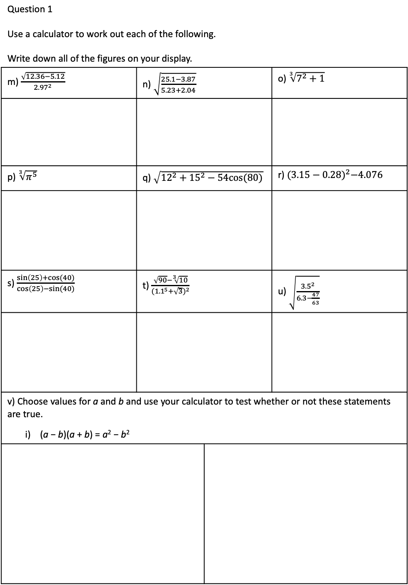
Independent Practice
Question 1 Use a calculator to work out each of the following. Write down all of the figures on your display.
m) $\frac{\sqrt{12.36−5.12}}{{2.97}^{2}}$ | n) $\sqrt{\frac{25.1−3.87}{5.23+2.04}}$ |  | o) $\sqrt[3]{7^{2}+1}$
p) $\sqrt[3]{π^{5}}$ | q) $\sqrt{{12}^{2}+{15}^{2}−54cos⁡(80)}$ |  | r) ${(3.15−0.28)}^{2}−4.076$
s) $\frac{\sin\left(25\right)+cos⁡(40)}{\cos\left(25\right)−sin⁡(40)}$ | t) $\frac{\sqrt{90}−\sqrt[3]{10}}{{({1.1}^{5}+\sqrt{3})}^{2}}$ |  | u) $\sqrt{\frac{{3.5}^{2}}{6.3−\frac{47}{63}}}$
v) Choose values for a and b and use your calculator to test whether or not these statements are true. i) (a − b)(a + b) = a² − b²
ii) (a + b)² = a² − 2ab + b²

